Slide 1


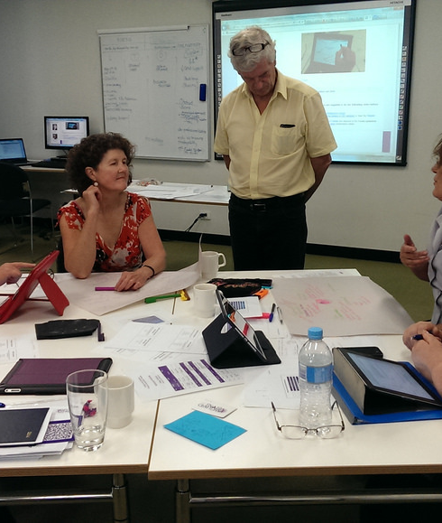
15 Survival Skills for Instructors in Higher Education

Slide 2

Based on a Magna Presentation by:
Dr. Peter Saunders,
Oregon State University CTL (2007)

Slide 3

“ The only person who is educated is the one who has learned how to learn…and change. ”
(Carl Rogers)

Slide 4

Survival Strategy 1:
Prepare, Teach, Reflect, Revise
Myth 1: Talking is teaching
Teaching without learning is just talking. (T. Angelo)
Myth 2: Hearing equals learning
Hearing without comprehension is just sound.

Slide 5
Survival Strategy 2:
Set and Manage Learner Expectations & Behaviour
Set expectations early and reinforce them – use your Course Outline (which is your contract with your students)
Include the answers to: Who? What? Why? When? Where? and How?
Used for class management tool (deadlines, grading, late assignments, assessment…)

Slide 6
Survival Strategy 3:
Communicate your Expectations Often & Stick to Them
Tips:
Put them in writing!
Say them orally
Outline consequences for those who interfere with your teaching and your students’ learning.

Slide 7
Survival Strategy 4:
Focus on both the Process of Learning & Mastery of Content
Tips:
Make self-reflection in the learning process an assessed portion of assignments
Make assessment fun and a social activity

Slide 8
Survival Strategy 5:
Create a Safe Learning Environment
Tip: Create learning ground rules
One speaker at a time
Keep an open mind
Everyone participates, no one dominates
There are no mistakes just ideas to aid in the learning process

Slide 9
Survival Strategy 6:
Emphasize Time on Task
Tips:
Set short time limits for in class assignments
Use timers if necessary (Smartboard)

Slide 10
Survival Strategy 7:
Learn their names!
Tip:
There are many memory assisting techniques to aid in learning your students names…use them!
Daily warm up activities using names are essential at the beginning of a course.

Slide 11
Survival Strategy 8:
Be professional and friendly, but not their friend
Tip:
You are their Instructor and you must maintain a professional relationship with your students.

Slide 12
Survival Strategy 9:
Use relevant anticipatory sets to focus minds and hearts
Anticipatory sets are a brief activity or event at the beginning of the lesson that engages all students’ attention and focuses their thoughts on the learning objective.

Slide 13
Anticipatory set Criteria:
They should:
Have direct relevance to the instructional objective
Be linked to students’ lives, their world
Provide label to help store and retrieve content
Examples:
Questions, demonstrations, pictures, sample quiz question, common experience – headline news, recent scientific breakthrough

Slide 14

Survival Strategy 10:
Tap into the power of peer pressure and admiration
Observation: students care enormously what other students think about them.
Tips:
Use teams often to draw on this social need
Have teams report and present to other teams
Have teams “compete” against other teams
Have teams support other teams

Slide 15
Survival Strategy 11:
Engage learners in activities that are meaningful to them whenever possible
Relate the content to their area of study
How will this apply to their career?
Relevance to objectives of course

Slide 16
Survival Strategy 12:
Vary lectures with in-class activities
Tips:
Instead of lecturing all Chapters assign learning teams
Devote your classroom time to in-class applied activities (get them up and moving!)
Explore Flipped Classrooms

Slide 17
Survival Strategy 13:
Integrate technology that supports student achievement of learning outcomes
Power Point slides to highlight the main concepts
Brightspace for additional readings
Educational technologies for concept mapping, essay development, accounting software, graphing and charting….

Slide 18
Survival Strategy 14:
Provide feedback on learning often – use assessment tools and give credit for assessment activities & self-reflections
SPUNKI
Recipe card reflection
Graphic representation of concepts
Provide a sample test question based on the class …

Slide 19
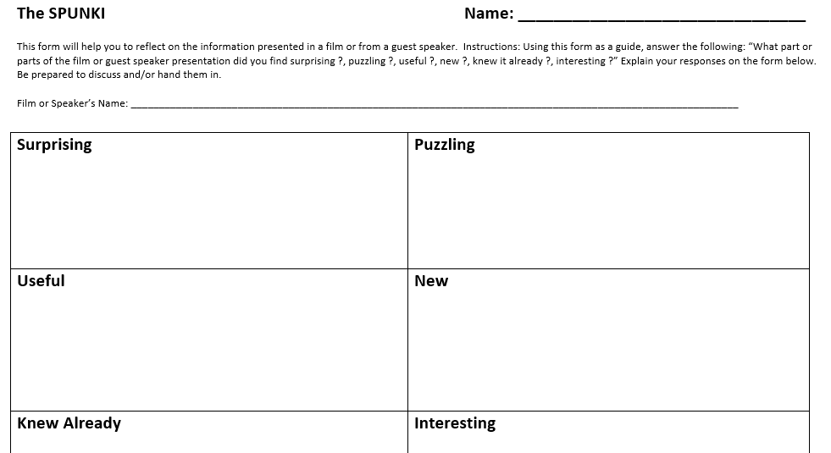

Slide 20
Survival Strategy 15:
Show your enthusiasm for your subject area and have fun!
NOTE:
Integrate your strategies slowly at a rate your feel comfortable with.
If you are bored so are they! ☺

Slide 21
Survival Strategies Review
Strategy
1
Prepare, Teach, Reflect, Revise
Strategy
2
Set expectations early & reinforce
Strategy
3
Communicate your policies and stick to them
Strategy
4
Strategy
5
Focus on both the process of learning & the mastery of content
Create a safe environment – establish learning ground rules

Slide 22
Survival Strategies Review
Strategy
6
Emphasis time on task
Strategy
7
Learn their names
Strategy
8
Be friendly but not their friend
Strategy
9
Strategy
10
Use relevant anticipatory sets to focus mind and hearts
Tap the power of peer pressure and peer admiration

Slide 23
Survival Strategies Review
Strategy
11
Engage learners in activities that are meaningful
Strategy
12
Vary lectures and in-class activities
Strategy
13
Integrate technology that supports achievement of learning outcomes
Strategy
14
Strategy
15
Provide feedback on learning often – use assessment tools
Show your enthusiasm for your subject area & have fun

Slide 24


“Knowledge increases in proportion to its use – that is, the more we teach the more we learn.”
(H. P. Blavatsky, Oregon State University)

